Slide 1

Usecase Model Supplemental Material
University of Science, VNU-HCM
Faculty of Information Technology
Assoc. Prof. TRAN Minh Triet
Department of Software Engineering
Software Analysis and Design

Slide 2
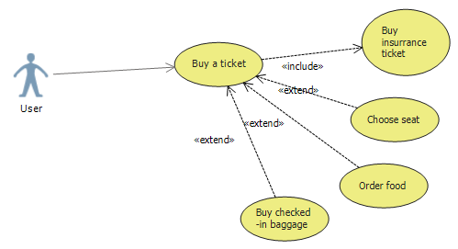
<<include>> and <<extend>>

Slide 3
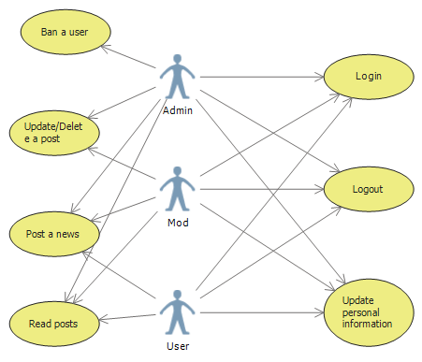
Actor Generalization
Without actor generalization

Slide 4
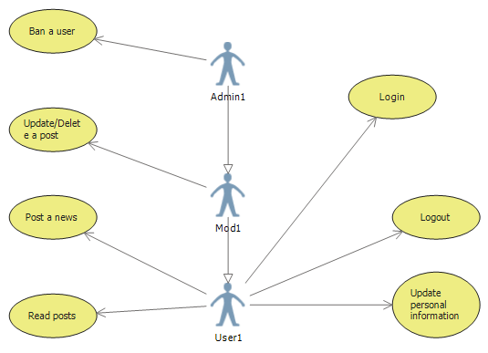
Actor Generalization
With actor generalization

Slide 5
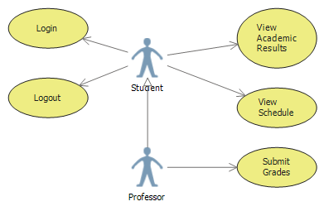
Actor Genelization
Invalid Actor Generalization!

Slide 6
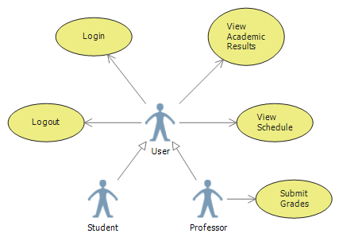
Actor Genelization
Revised solution

